Slide 1
технікИ тест дизаЙну
ІП-16-1
Калатурний Антон

Slide 2
Завдання:
Мета роботи: навчитися використовувати техніки тест дизайну для визначення набору тестів.
Variant 6
Equivalence partitioning and Boundary value analysis
A system is designed to calculate the electricity cost. User can enter only an old and a new values of electricity counter and press Calc button. If data entered correctly and user consumed less than 100 kw the price of 1 kw will be 25 cents. The calculator will count 1$ per 1 kw for more than 600 kw. In another case it will count 65 cents per 1 kw.
1. Build equivalence classes (partitions) based on given information
2. Stand Out boundary values

Slide 3
1. Equivalence partitioning and Boundary value analysis
If [1-99] kw consumed, 1 kw = 25 cents
If [100-600] kw consumed, 1 kw = 65 cents
If [601-(+inf)) kw consumed, 1 kw = 1 $
Boundary values:
0, 1, 99
100, 600
601, 602

Slide 4
2. Decision tables
If you are a new client in the caffe you get a discount card with 0 points. Every time you make an order in a caffe you will receive points on the card. If you are existing customer and have on your discount card more than 5 000 points you will get 10% discounts every time you visit the caffe. If you have a Gift Coupon – you will get one-time 25% discount. This discount cannot be used with discount card but points will added to card.
Build decision table based on given information.
Condition | Rule 1 | Rule 2 | Rule 3 | Rule 4 | Rule 5 | Rule 6
Not a customer | T | F | F | F | F | T
Less than 5k | T | T | F | F | T | T
More than 5k | F | F | T | T | F | F
Gift Coupon | F | F | F | T | T | T
Total discount | 0% | 0% | 10% | 25% | 25% | 25%

Slide 5
3. State transition
User is doing an order on the web-store. He selects some goods from the catalog and clicks on “Add to cart” button. If one/more selected goods aren’t available user will get the corresponding message and will be asked to correct the selection. If all selected goods are available user will get message: “Do you want to go to shopping cart? Yes/No”. If the user press “No” button, he will stay on the catalog of goods to continue the selection.
To complete the order user should click “Yes” and after redirection to the Cart confirm the order by entering his phone number and delivery address and clicking on “Confirm the order” button. If entered data is correct the user will get the message on his phone with short info about the order. If some entered data is incorrect, user will get an error message and will be asked to Confirm the order again.
Build state transition diagram based on given information
Cover requirements above by tests (write test cases’ names and objectives) based on state transition analysis

Slide 6
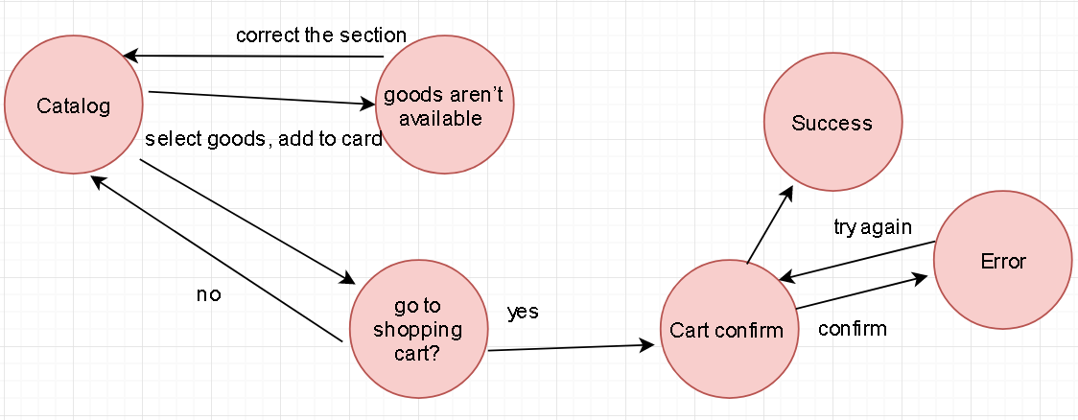
State transition

Slide 7
Test case 1
Check results on entering valid User Id & Password
Steps:
Open login page
Enter valid User Id & Password of existin user
Click “Login”
Expected result:
Successfully logged in

Slide 8
Test case 2
Check results on entering Invalid User ID & Password
Steps:
Open login page
Enter invalid User Id & Password of existing user
Click “Login”
Expected result:
“Please enter valid User Id & Password “ message produced

Slide 9
Test case 3
Check response when a User ID is Empty & Login Button is pressed
Steps:
Open login page
Leave User Id & Password fields empty
Click “Login”
Expected result:
“Please enter your User Id & Password “ message produced

Slide 10
Test case 5
Check results on adding goods which not exist
Steps:
Open catalog
Select some unavailable goods from the catalog
Clicks on “Add to cart”
Expected result:
Corresponding message ask to correct the selection

Slide 11
Test case 6
Check results on adding existing goods
Steps:
Open catalog
Select some available goods from the catalog
Clicks on “Add to cart”
Expected result:
Successfully added to cart

Slide 12
Test case 7
Check results redirection to Cart confirm
Steps:
Open catalog
Select some available goods from the catalog
Clicks on “Add to cart”
“Do you want to go to shopping cart?” Click “Yes”
Expected result:
Successfully redirected to Cart confirm

Slide 13
Test case 8
Check results for staying at catalog
Steps:
Open catalog
Select some available goods from the catalog
Clicks on “Add to cart”
“Do you want to go to shopping cart?” Click “No”
Expected result:
Catalog opened back

Slide 14
Test case 9
Check results for successful Cart confirm
Steps:
Open catalog
Select some available goods from the catalog
Clicks on “Add to cart”
“Do you want to go to shopping cart?” Click “Yes”
On Cart confirm enter correct data
Click “Submit”
Expected result:
Order submitted

Slide 15
Test case 10
Check results for incorrect Cart confirm
Steps:
Open catalog
Select some available goods from the catalog
Clicks on “Add to cart”
“Do you want to go to shopping cart?” Click “Yes”
On Cart confirm enter incorrect data
Click “Submit”
Expected result:
Message asks to Confirm the order again.

Slide 16
SLIDE TITLE
пTitle
ddhedhhdh

